Slide 1
Story Elements
Take notes on the different elements of a fiction story as you go through each slide.

Slide 2
Literary Devices of Fiction
Setting
Plot
Character
Conflict
Point of View
Theme
Mood
Dialogue
Rhetorical Devices
Flashback
Foreshadowing
Figurative Language
Sensory Details
Allusion

Slide 3
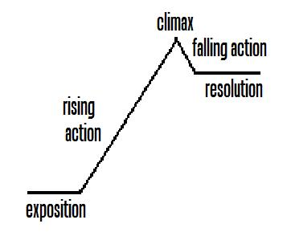
Plot (element)
Plot is the basic sequence of events in a story. In conventional stories, plot has five parts: exposition, rising action, climax, falling action, and resolution.
Notes:
Find relevant examples to provide to students in explaining these definitions: (elaborate on definitions as you see appropriate)
Exposition—used at the beginning of a work to explain to the reader the background information needed to understand the characters and their circumstances.
Rising action—a series of conflicts and crisis that lead to the climax
Climax—the turning point of action in a piece of fiction, the greatest moment of tension
Falling action—events following the climax of a piece of fiction that eventually lead to the conclusion or denouement
Denouement—the resolution of the plot in a piece of fiction
In media res—stories beginning in the middle of action

Slide 4
Elements of Plot
Exposition-the setting (time, place, season), introduction of characters, setting the scene
Rising Action-A series of events leading up to the climax, usually full of hooks, predictions can be made and foreshadowing and suspense may be present
Climax-The most exciting part of the plot
Falling Action-Denouement, A series of events leading to the resolution and closure
Resolution-Tying up all the loose ends of the literature (And they lived happily-ever-after.)

Slide 5
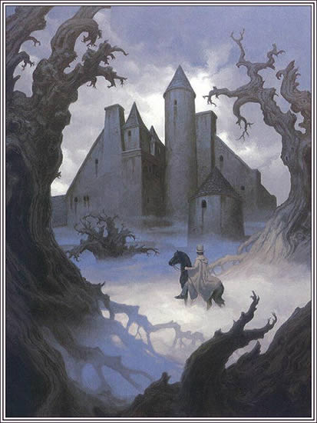
Setting (element)
The setting of a story is the time and place in which it occurs.
Elements of setting may include the physical, psychological, cultural, or historical background against which the story takes place.

Slide 6

Mood (element)
The mood of a story is the atmosphere or feeling created by the writer and expressed through setting.
Moody Faces

Slide 7

Conflict (element)
In literature, conflict is the opposition of persons or forces that brings about dramatic action central to the plot of a story.

Slide 8
Imagery and Dialogue
Imagery
Dialogue
The use of language to
create mental images and
sensory impressions.
Imagery can be used for
emotional effect and to
intensify the impact on the
reader.
The lines spoken between character in fiction or a play.

Slide 9
Sensory Details (techniques)
Sensory details are details in writing that describe what is seen, heard, smelled, tasted, or touched.
  Writers often use sensory details to enhance the mood and theme in writing.

Slide 10
Point of View-Narrator (element)
The narrator is the teller of a story.
  Reliable narrator—the reader accepts the statements of fact and judgment without serious question
  Unreliable narrator—the reader questions or seeks to qualify the statements of fact and judgment.
Notes:
Harmon, W. H. (1996). A handbook to literature (7th Edition ed.). Upper Saddle River: Prentice-Hall, Inc.

Slide 11
Point of View
The point of view is the perspective from which the events in the story are told. The author may choose to use any of the following:
  Omniscient/third-person omniscient
  Omniscient/third-person limited
  Objective
  First person/subjective
  Limited

Slide 12
Point of View
Omniscient/third-person omniscient—The narrator tells the story in third person from an all-knowing perspective. The knowledge is not limited by any one character’s view or behavior, as the narrator knows everything about all characters.
  Signal pronouns—he, she, they

Slide 13
Point of View
Omniscient/third-person limited—The narrator restricts his knowledge to one character’s view or behavior.
  Signal pronouns—he, she, they
Objective—The narrator reveals only the actions and words without the benefit of the inner thoughts and feelings.
  Signal pronouns—he, she, they

Slide 14
Point of View
First person/subjective—The narrator restricts the perspective to that of only one character to tell the story.
  Signal pronouns—I, we, us
Limited—A narrative mode in which the story is told through the point of view of a single character and is limited to what he or she sees, hears, feels, or is told.
  Signal pronouns—I, we, us

Slide 15
Theme (element)
The theme is the central or universal idea of a piece of fiction; it is a perception about life and the human condition.
  An implicit theme refers to the author’s ability to construct a piece in such a way that through inference the reader understands the theme.

Slide 16
Theme
The theme is also the main idea of a nonfiction essay.
  An explicit theme refers to when the author overtly states the theme somewhere in the work.

Slide 17
Theme
A universal theme transcends social and cultural boundaries and speaks to a common human experience.
The human condition encompasses all of the experience of being human. The ongoing way in which humans react to or cope with these events is the human condition.
Notes:
http://www.reference.com/browse/human+condition

Slide 18
Types of Characters (element)
Dynamic character—a character which changes during the course of a story or novel
Static character—a character who remains primarily the same during the course of a story or novel
Notes:
Review the types of characters with students.

Slide 19
Types of Characters
Round character—a well developed character who demonstrates varied and sometimes contradictory traits
Flat character—a two-dimensional and relatively uncomplicated character who does not change throughout a story or novel
  Stock Character—a special kind of flat character who is instantly recognizable (stereotypical)
Notes:
Review the types of characters with students.

Slide 20
Types of Characters
Protagonist—the story’s main character
Antagonist—a character in opposition of the protagonist
Character Foil—a secondary character who contrasts with the protagonist in order to highlight aspects of the main character’s personality
Notes:
Review the types of characters with students.

Slide 21
Types of Conflict
Character versus Character—a conflict between one character and another
Character versus Nature—a conflict between a character and a force of nature
Character versus Society—a conflict between a character and the values, beliefs, and/or customs of a larger group
Character versus Self—an internal psychological conflict within a character

Slide 22
Character Development
Internal Character Development
  Feelings
  Thoughts
  Emotions
External Character Development
  Actions
  Relationships
  Dialogues

Slide 23
Character Motivation
Character Motivation—the reasons, justifications, and explanations for the action of a character
  Motivation results from a combination of the character’s moral nature with the circumstances in which the character is placed.
  Motivation helps to determine what the character does, says, and feels or fails to feel.
Notes:
Harmon, W. H. (1996). A handbook to literature (7th Edition ed.). Upper Saddle River: Prentice-Hall, Inc.

Slide 24

Characterization – the way an author reveals the special qualities and personalities of a character in a story, making the character believable.

Slide 25
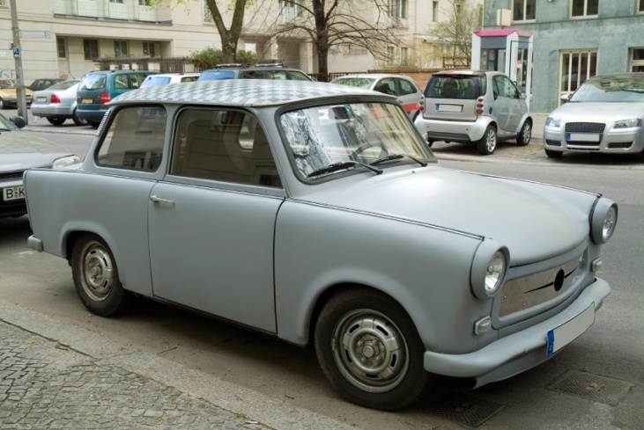
Analyzing Character Traits
We try to figure out what a character in a book is like by paying attention to the clues the author gives us. This is called “making inferences.”
Example: What can you infer?
“No, Honey, I don’t want you to spend a lot of money on my birthday present. Just having you for a husband is the only gift I need. In fact, I’ll just drive my old rusty bucket of bolts down to the mall and buy myself a little present. And if the poor old car doesn't break down, I’ll be back soon.”

Slide 26
Types
There are two types of characterization:
Direct
Indirect.

Slide 27
Direct Characterization
Direct characterization is when the author TELLS the audience what the personality of the character is.
Example: “The patient boy and quiet girl were both at the game.”

Slide 28
Indirect Characterization
Indirect characterization is when the author SHOWS things that reveal the personality of the character.
There are FIVE different methods of indirect characterization: speech, thoughts, effect on other characters, actions, and looks.

Slide 29
Indirect Characterization – writer shows you what character is like by revealing:
S- Speech
T- Thoughts
E- Effect on Others
A- Actions
L- Looks

Slide 30
The Difference
The difference between direct characterization and indirect characterization is TELLING v. SHOWING!
Indirect characterizations are like clues about the characters. There is no mystery with direct characterization because the author gives us the information we need to know!

Slide 31

Speech– We often get to know characters because of what they say to each other.
Anita threw her arms around Tony and gave him a big hug. “Thank you so much for being there for me,” she said. “I don’t think I could have faced my parents without you.”
thoughtful compassionate appreciative

Slide 32

Thoughts– When an author lets us get inside the mind of a character, we can often learn a great deal about him or her.
Butch looked around the neighborhood. “This would be a safe place to play catch with Bobby,” he thought. “Why doesn’t Bobby throw the ball?” He must be in a bad mood or something.”
loyal concerned playful

Slide 33
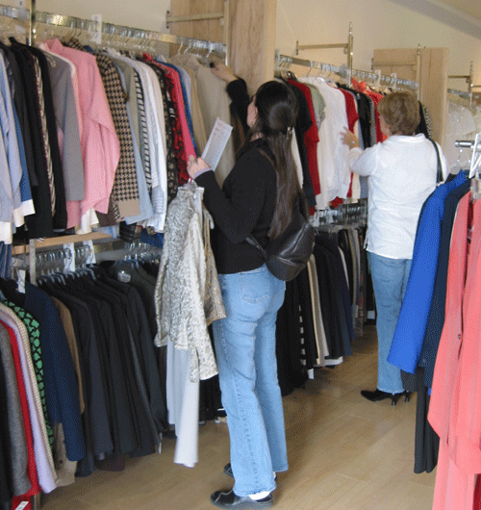
Effect On Others– sometimes other characters will tell us something useful about the character we’re reading about.
“You wouldn’t believe what Lisa did yesterday,” Sara said to her sister. “When we went into the bridal shop, she pushed all the women aside and demanded that the sales lady help us immediately. It was really something!”
Demanding pushy assertive

Slide 34
Actions – Much of what we learn about characters is revealed to us through what they do.
Denise picked up the slimy bull frog. She could hardly stand to hold it even for a moment. She held it out at arm’s length from her body and quickly carried it to her brother.
squeamish sensitive nervous

Slide 35
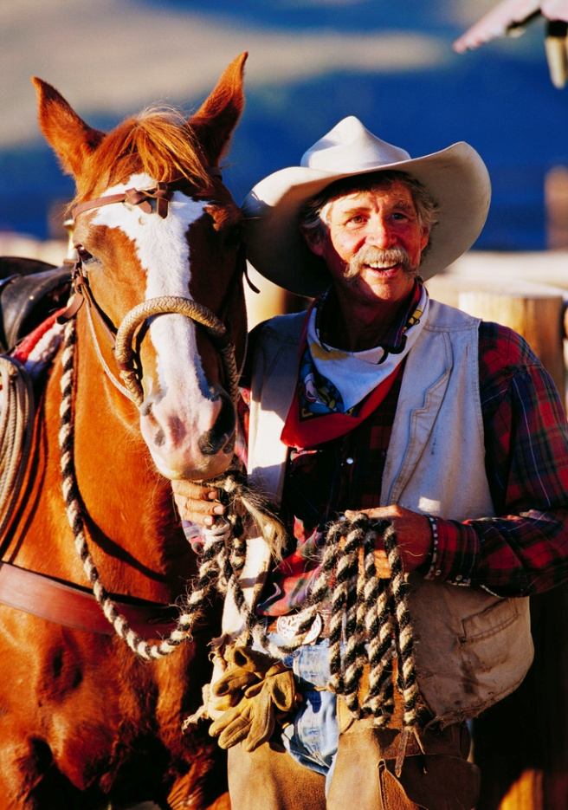
Looks
Can infer a lot about characters from the clothes they wear, their facial features, their body language, and their mannerisms.
Tex was the head rancher on the farm. When he rounds up the horses, he can be easily spotted with his beige hat and vest. Tex’s smile is a mile wild, even with his bushy mustache.
jovial proud dedicated

Slide 36
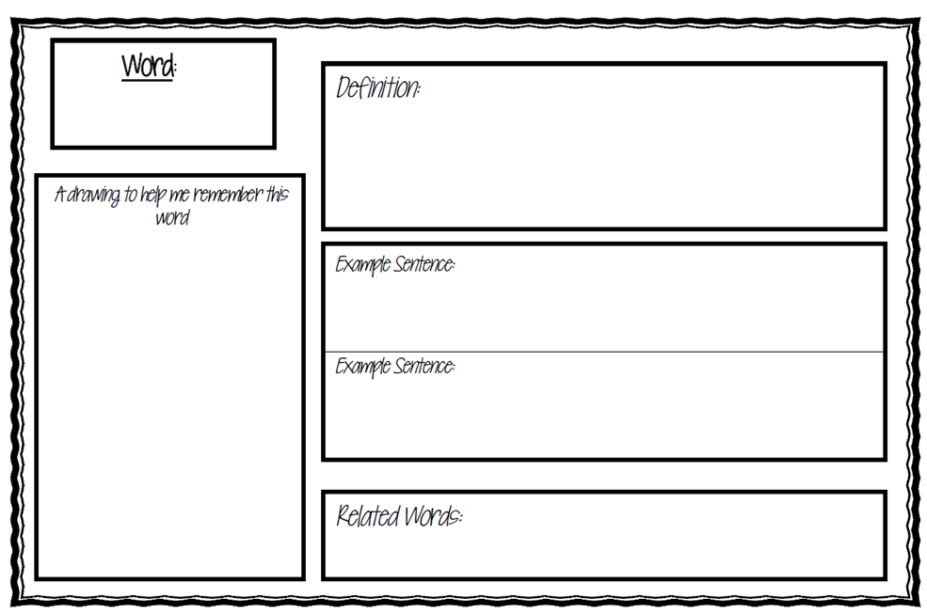
Closing
Complete a Vocabulary Study to your Vocabulary Study Unit 1 Sheet for each of the following terms:
Direct Characterization
Indirect Characterization
Static Character
Dynamic Character
Round Character
Flat Character

